Slide 1
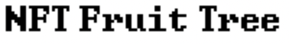
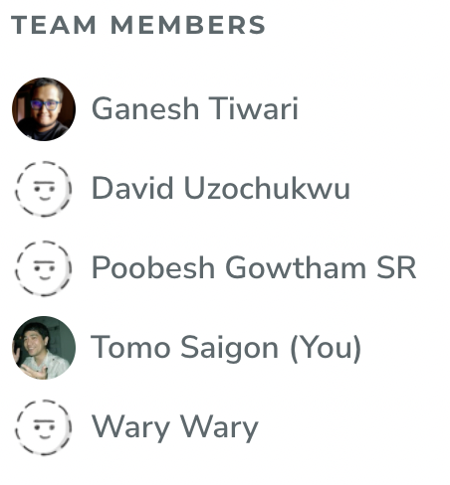
NFT.Fruit.Tree
A Virtual Yield Farming Game
Made for DecentralHacks 2021
https://github.com/NFT-Fruit-Tree/fruittree
Presented by / Contact: @tomoXtechno / tomo#2515

Slide 2
Inspiration
Inspiration

Slide 3
Tamagotchi
Virtual Pet
Axie Infinity
Play to Earn
NFT
Pixel Art
Decentraland
Digital Land
Hyper Casual
Farming

Slide 4
-NFT FRUIT TREE-
is a
hyper casual
play-to-earn
8-bit pixel
virtual Yield Farming
metaverse
NFT game
with in-game currency

Slide 5
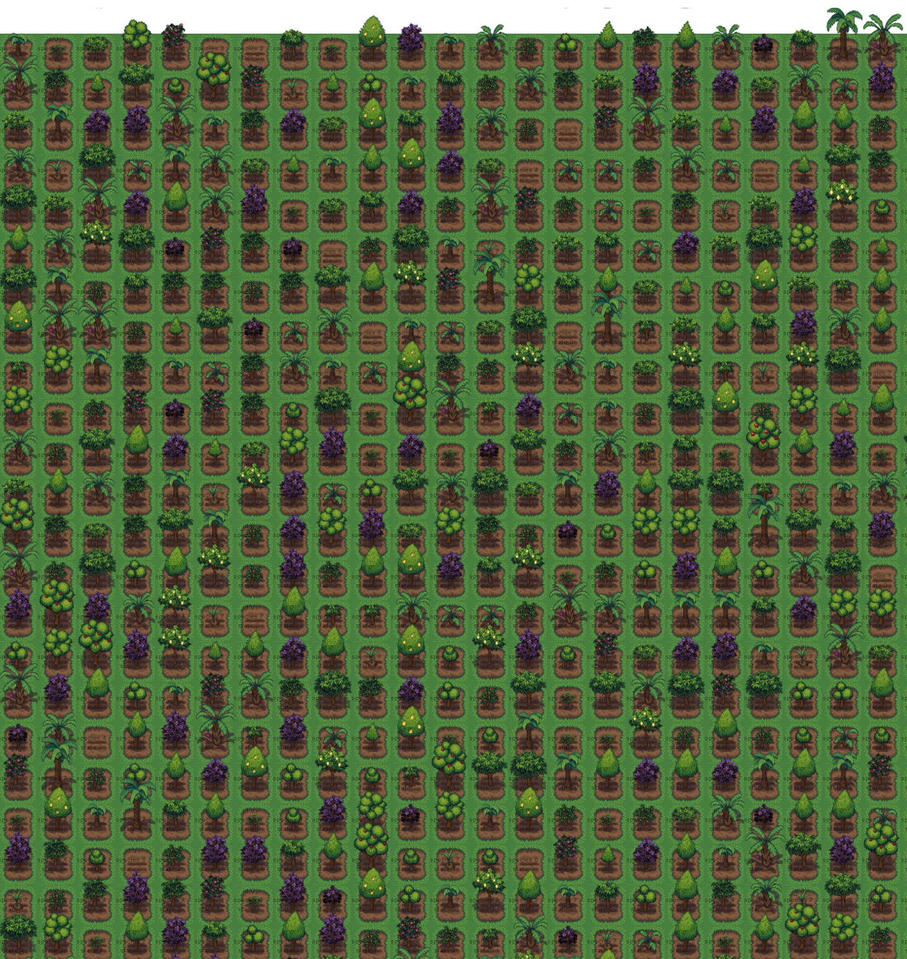
Tend Your NFT Land & Trees for ERC-20 Rewards
Game Play
Mint a random* unique “Seed”
Plant it on your “Land” on world map
Water and tend daily to sprout and grow into a mature tree
Fertilize your tree (with interest-bearing tokens) to produce “Fruit”
Harvest your fruit to get more Seeds, Land, or MATIC
PROFIT!
Unpredictable Plant DNA based on luck and blockchain!
Chainlink VRF or other on-chain entropy

Slide 6
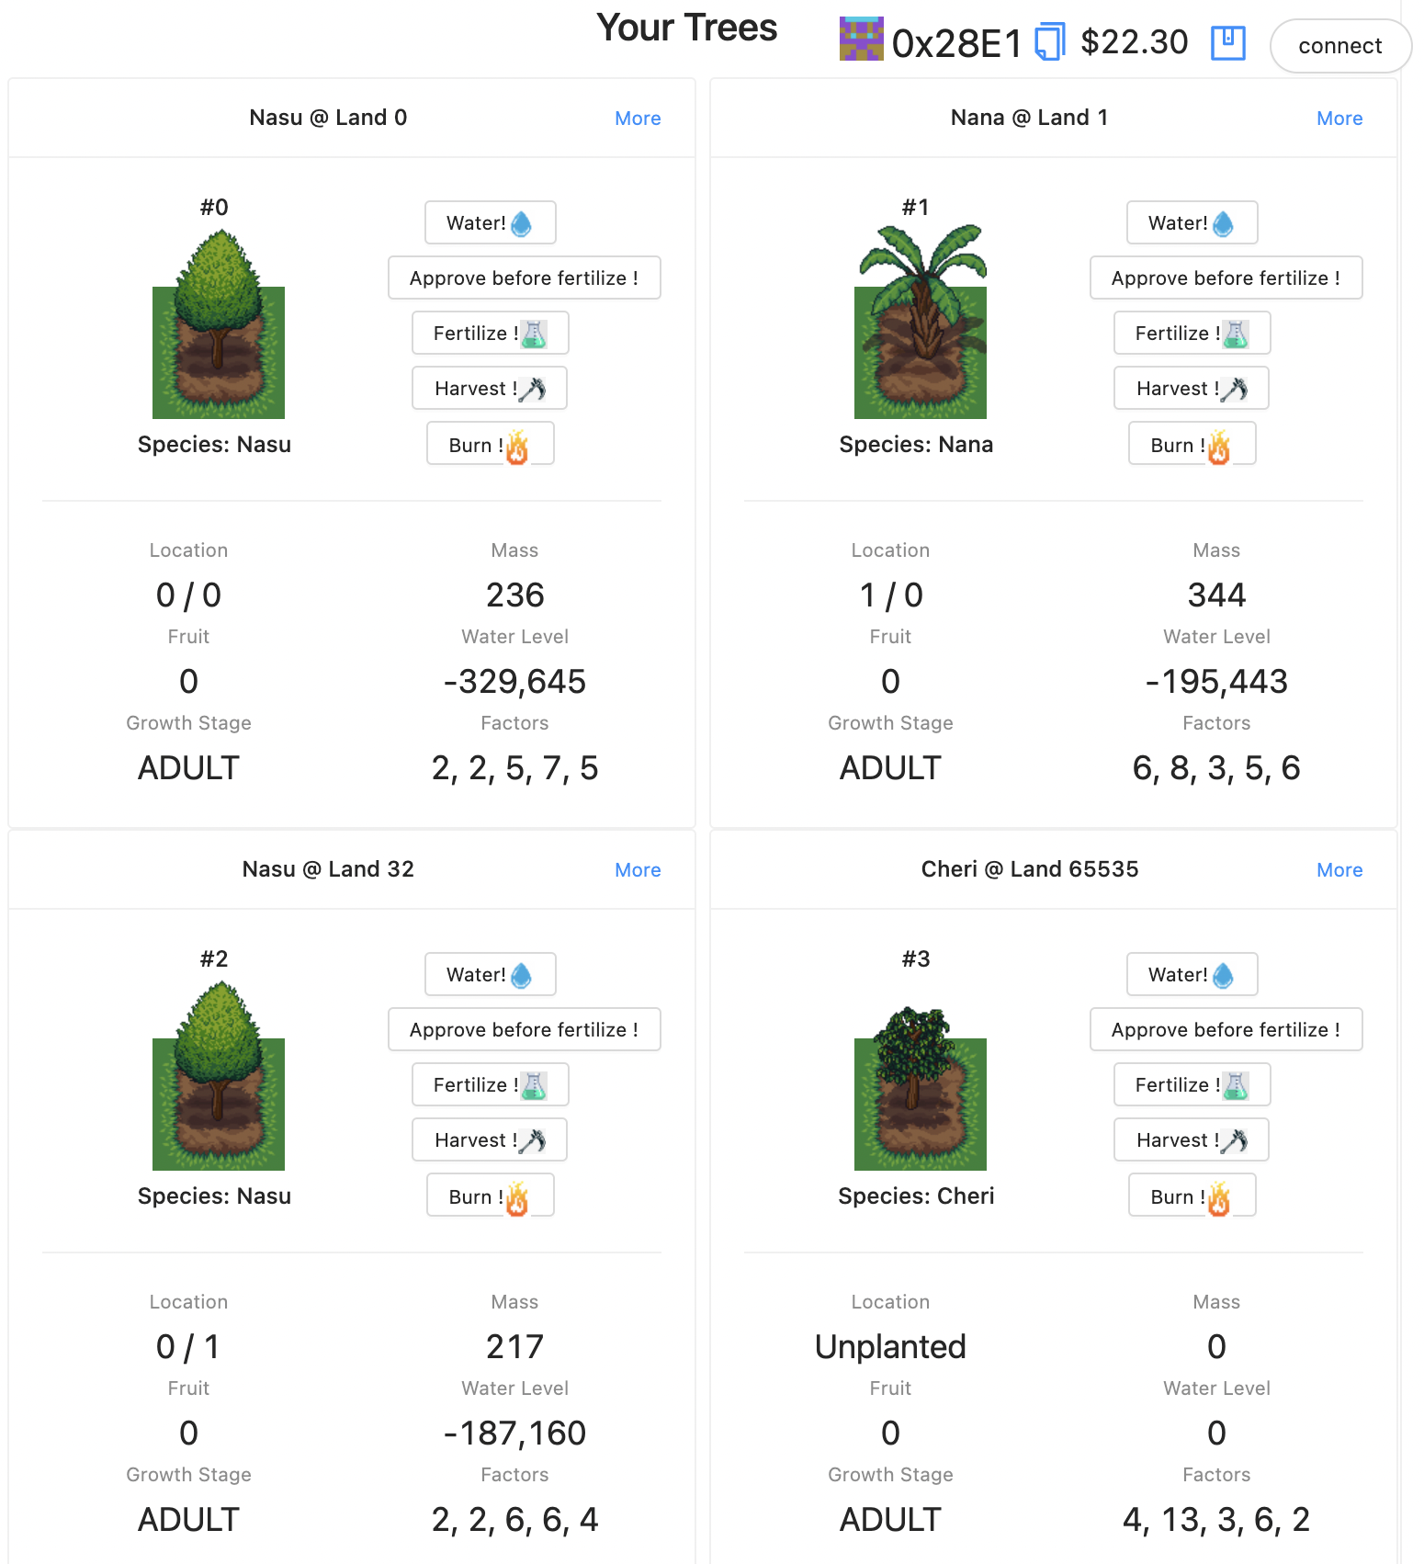
Trees are NFTs
…so is Land!
Trade rare Seeds or Trees
Move your farm to the most fertile Land
Help friends water their Trees
Extract valuable interest-bearing tokens from harvested Fruit tokens
Internal market for Seeds creates price floor for farmed Fruit tokens

Slide 7
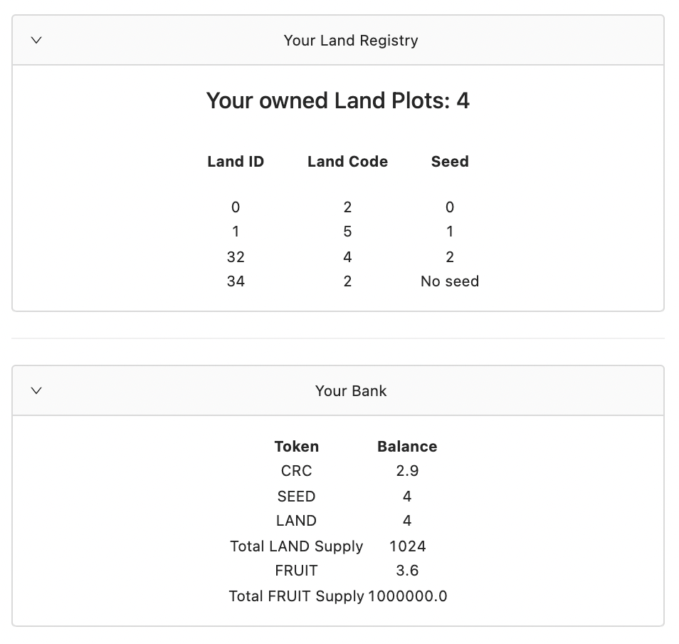
Token Inventory
The more FRUIT you
have…
the more LAND you can
buy…
the more SEEDs you can
plant…
the more FRUIT you can
grow!

Slide 8
Game Tokenomics
Land NFTs minted and owned by contract when deployed
Land sold to buyers from contract at exponentially increasing price
Fruit tokens (ERC-20 on dex) needed to mint Seeds
Seeds are minted with random DNA with extra features
Fruit yield farming speed controlled by DNA of Seeds and Land on a curve
Tree species have rarity level on a random curve
Game encourages perpetual funding (fertilizer)
Lock up interest-bearing tokens

Slide 9
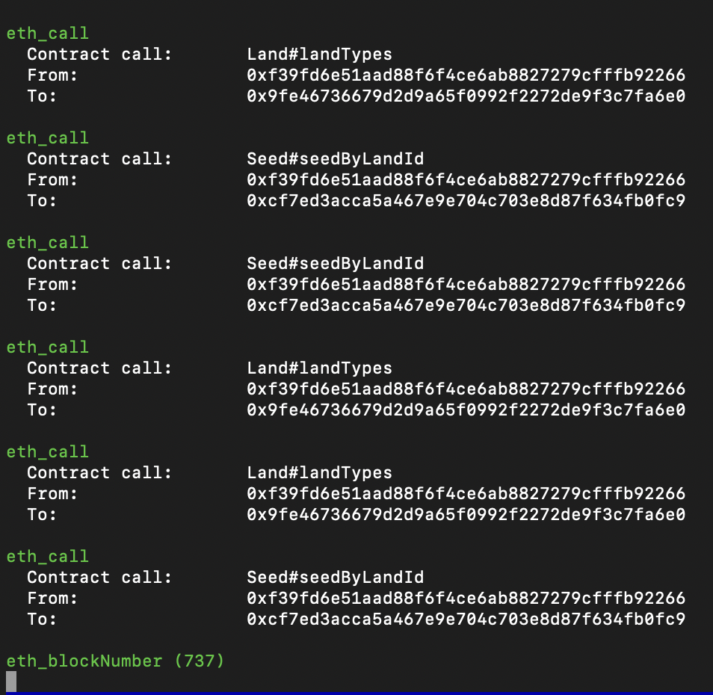
Built With
OpenZeppelin audited contracts
Scaffold-eth React Framework
Hardhat
Latest Solidity
2D Game Art
Pluggable interest-bearing tokens
Deploy to any EVM blockchain
*“N.F.T.” stands for “NFT Fruit Tree”

Slide 10
Status:
Proof of Concept Complete!
Serverless static front-end (React) viewing and controlling games via wallet connecting to functional smart contracts. Ready to deploy to any EVM blockchain and host on GH Pages, Netlify, etc.
Next Steps:
Partner with (interest-bearing) tokens to stake into our farm to create demand and use case for project tokens
Choose EVM sidechain (Polygon, Avalanche, Arbitrum, BSC, etc.) to deploy on
Raise funds from Initial Land Offering?

Slide 11
Thanks for watching!
NFT Fruit Tree Gang
Contact: @tomoXtechno | Discord: tomo#2515

